Slide 1
Isaac OLdton
Presentation

Slide 2


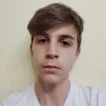
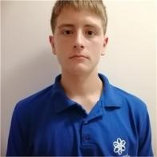
The team
Yordan Stoyanov
Scrum Trainer
Daniil Furnika
Backend Developer
PETAR MATSALIEV
Backend Developer
Ivan Chelebiev
QA Engineer

Slide 3
Work Stages
01
02
03
04
05
Organizing and Forming the Team
Forming the Main Concept
Planning and Distributing Roles
Intensive Work
Presentation

Slide 4





Used technology and languages

Slide 5
Ideas to expand

